Slide 1
Retreival Practice 4 Self-Test Solutions
Test 1: Solutions
Test 2: Solutions
Test 3: Solutions
Test 3: Solutions
Test 5: Solutions
Test 6: Solutions

Slide 2
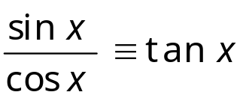
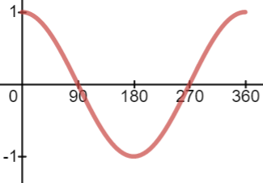
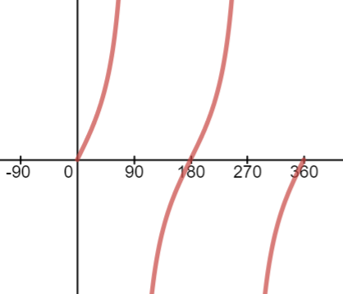
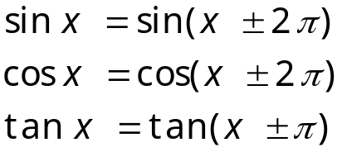



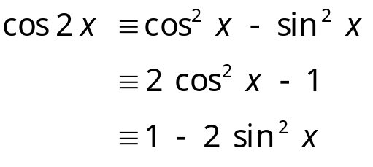


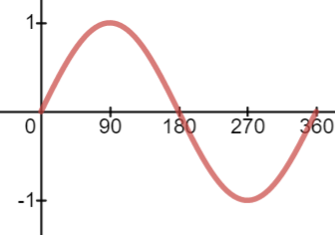

Self-Test Sheet 1 - Solutions
1.
6.
2.
7.
3.
8.
9.
4.
5.
10.

Slide 3
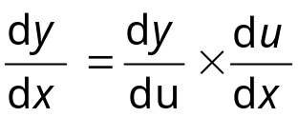
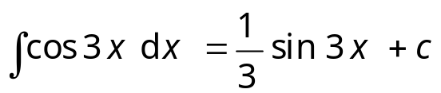
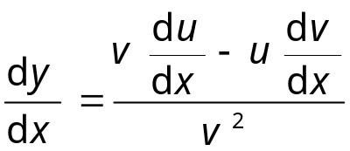
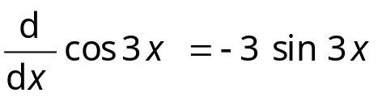
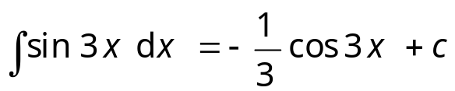
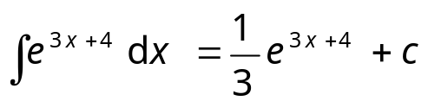
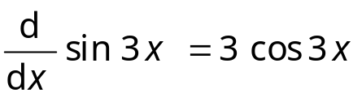
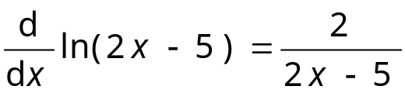
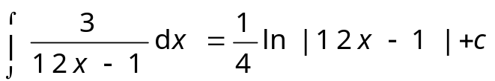
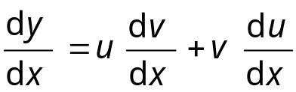
Self-Test Sheet 2 - Solutions
1.
6.
2.
7.
8.
3.
9.
4.
5.
10.

Slide 4

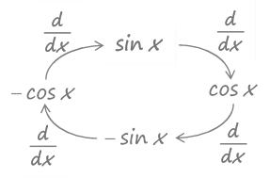
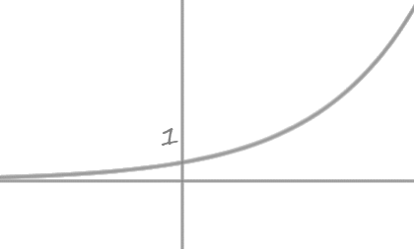


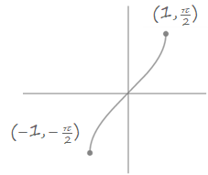
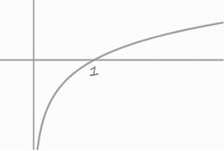
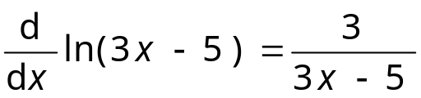


Self-Test Sheet 3 – Solutions (Page 1 of 2)
1.
6.
2.
7.
3.
8.
4.
9.
5.
10.

Slide 5
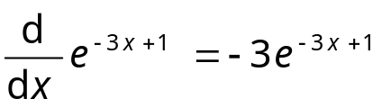
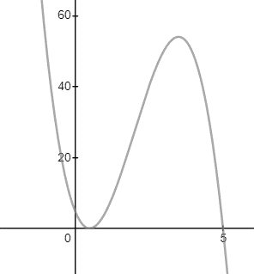
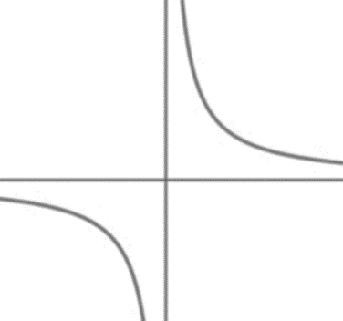


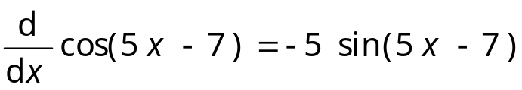
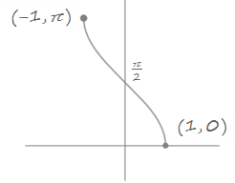
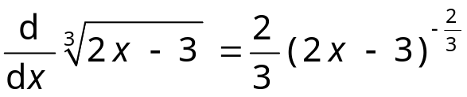
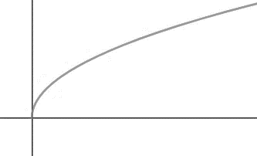



Self-Test Sheet 3 – Solutions (Page 2 of 2)
11.
16.
12.
17.
13.
18.
14.
19.
15.
20.

Slide 6
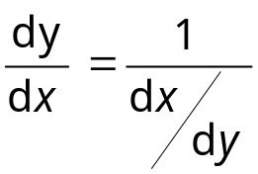
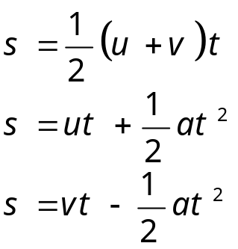
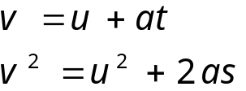

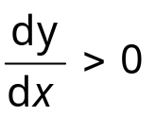


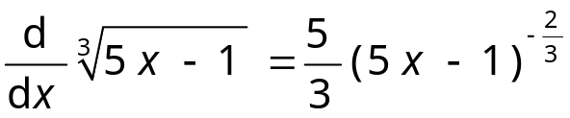
Self-Test Sheet 4 – Solutions (Page 1 of 2)
1.
6.
2.
7.
3.
4.
8.
9.
5.

Slide 7

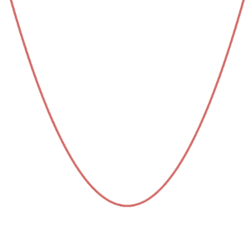
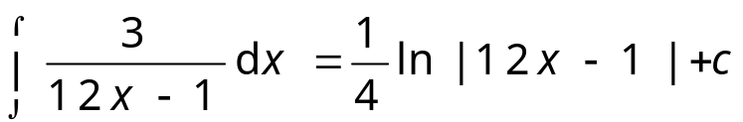

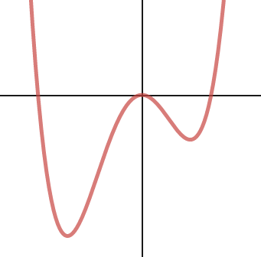
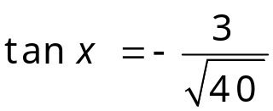








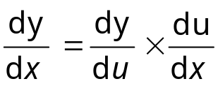

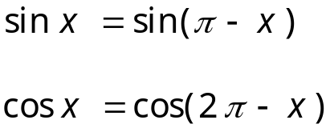
Self-Test Sheet 4 – Solutions (Page 2 of 2)
10.
14.
11.
15.
16.
12.
17.
13.
18.

Slide 8


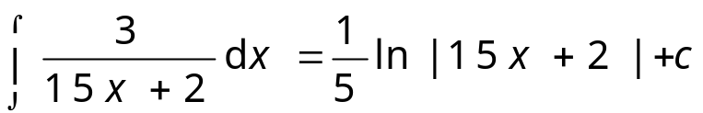
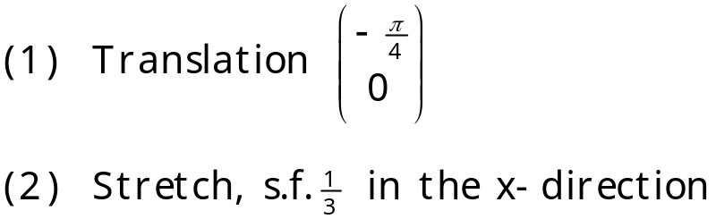


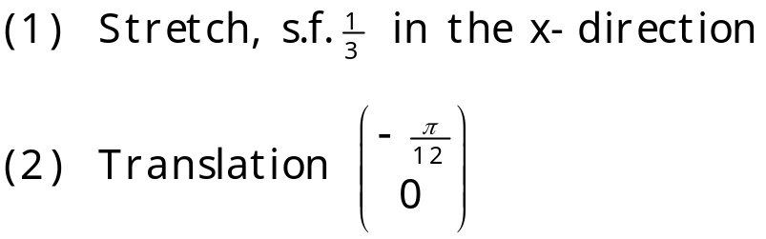
Retrieval Practice Test 5 – Solutions (Page 1 of 2)
1.
4.
5.
6.
Two possible answers:
2.
3.
-or-

Slide 9
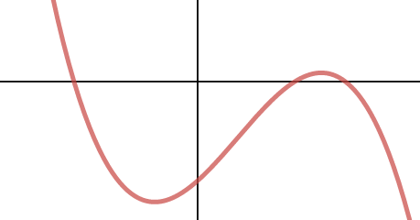



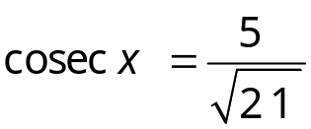
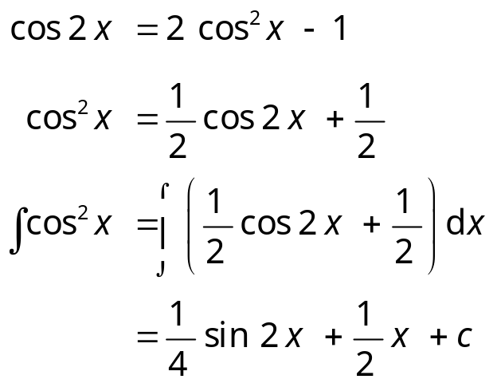

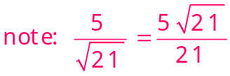
Retrieval Practice Test 5 – Solutions (Page 2 of 2)
7.
10.
11.
8.
12.
9.

Slide 10
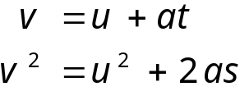
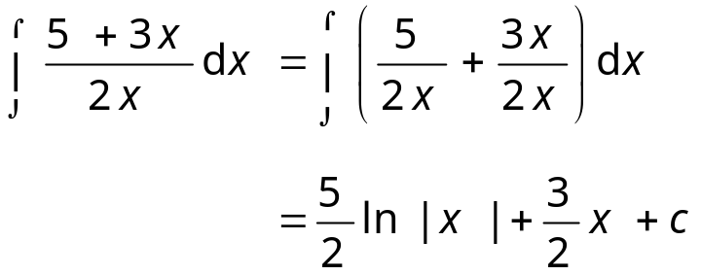

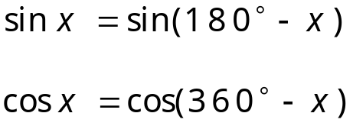
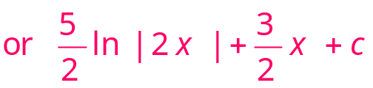
Retrieval Practice Test 6 – Solutions (Page 1 of 3)
1.
3.
2.
4.
5.

Slide 11







Retrieval Practice Test 6 – Solutions (Page 2 of 3)
6.
Two possible answers:
7.
-or-
8.

Slide 12


Retrieval Practice Test 6 – Solutions (Page 3 of 3)
9.
Constant Probability
12.
Two Outcomes
Independent events
Fixed Number of Trials
10.
11.

Slide 13





Retrieval Practice Test 7 – Solutions (Page 1 of 3)
1.
3.
4.
5.
2.

Slide 14





Retrieval Practice Test 7 – Solutions (Page 2 of 3)
6.
Two possible answers:
7.
-or-
8.

Slide 15



Retrieval Practice Test 7 – Solutions (Page 3 of 3)
9.
Constant Probability
12.
Two Outcomes
Independent events
Fixed Number of Trials
10.
11.

