Slide 1
Retreival Practice 4 Self-Test Solutions
Test 2: Solutions
Test 3: Solutions

Slide 2
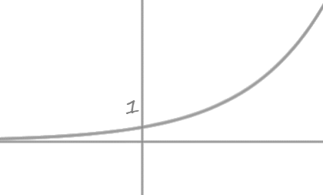
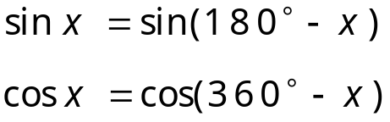

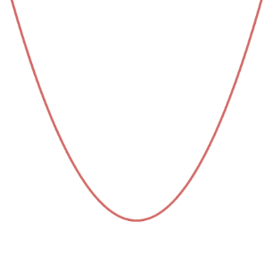


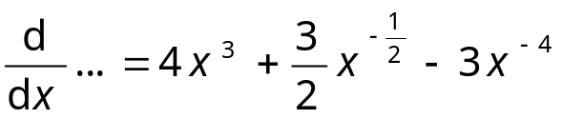
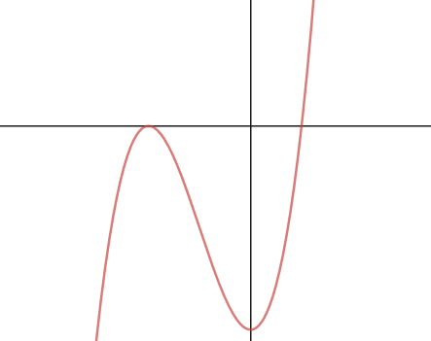












Self-Test Sheet 2 – Solutions (Page 1 of 2)
1.
5.
$$38\%$$
$$87\%$$
6.
$$60\%$$
2.
7.
$$80\%$$
3.
$$87\%$$
4.
$$51\%$$
$$78\%$$

Slide 3


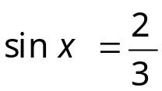
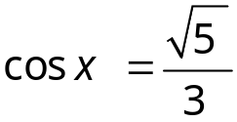


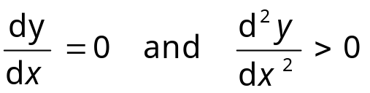





Self-Test Sheet 2 – Solutions (Page 1 of 2)
8.
$$7\%$$
11.
$$20\%$$
9.
Constant Probability
$$4\%$$
12.
$$0\%$$
Two Outcomes
Independent events
Fixed Number of Trials
10.
$$18\%$$

Slide 4
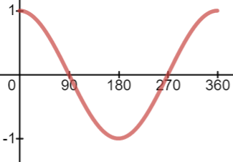
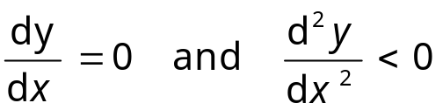


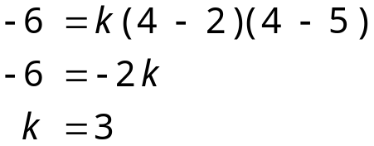
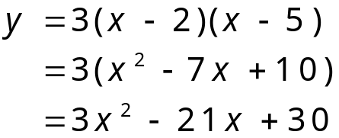
Self-Test Sheet 3 – Solutions (Page 1 of 2)
1.
4.
5.
2.
6.
3.
Constant Probability
Two Outcomes
Independent events
Fixed Number of Trials

Slide 5
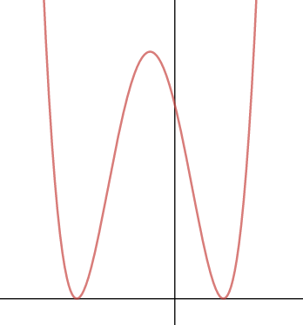



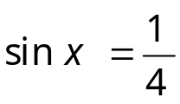


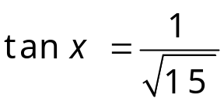
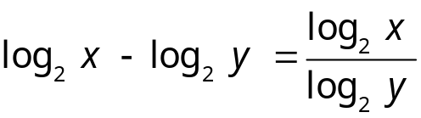

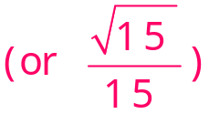


Self-Test Sheet 3 – Solutions (Page 1 of 2)
7.
10.
11.
12.
8.
9.
false
true
false

Slide 6
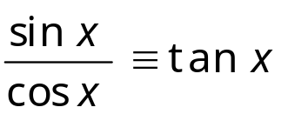
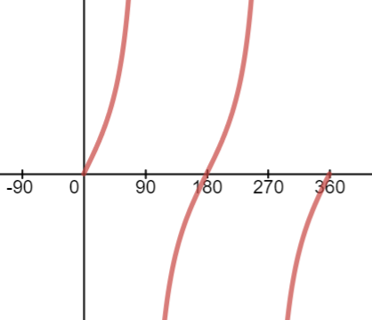


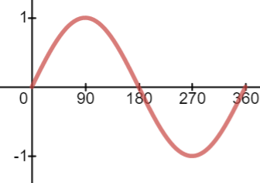
Self-Test Sheet 3 - Solutions
1.
6.
2.
7.
3.
8.
9.
4.
5.
10.

Slide 7
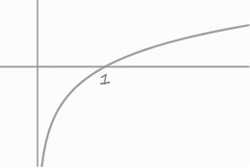


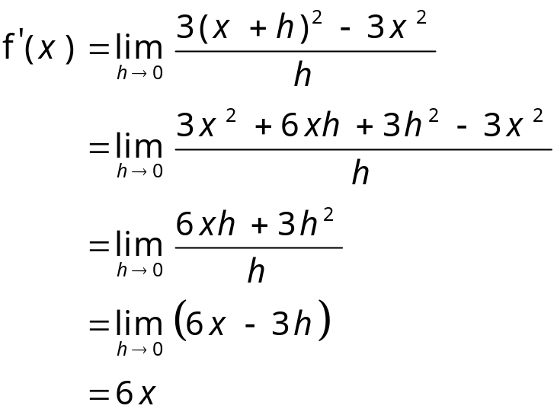
Self-Test Sheet 3 - Solutions
1.
4.
5.
2.
6.
3.
Constant Probability
Two Outcomes
Independent events
Fixed Number of Trials

Slide 8
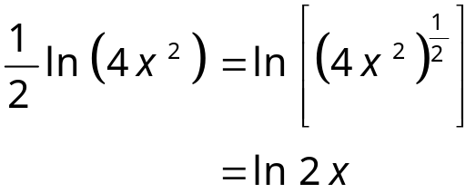
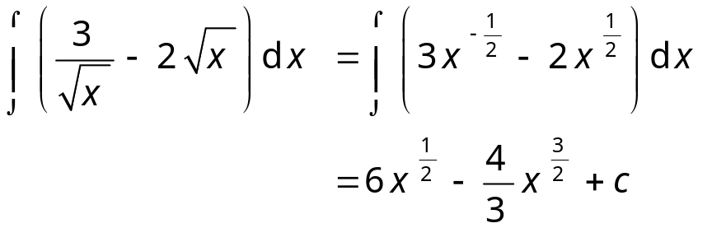
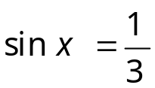
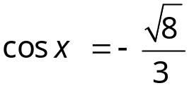

Self-Test Sheet 2 - Solutions
7.
10.
11.
8.
12.
9.
Acceleration is gradient
Distance is area under the curve.

